Slide 1

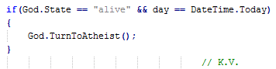
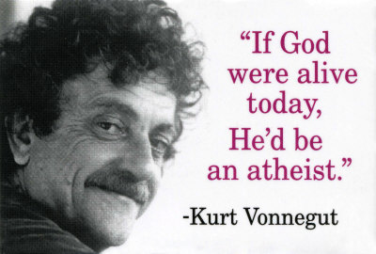
Information Technologies Practice Test
Prepared by:
Kurt Vonnegut Team
Telerik Software Academy
academy.telerik.com

Slide 2
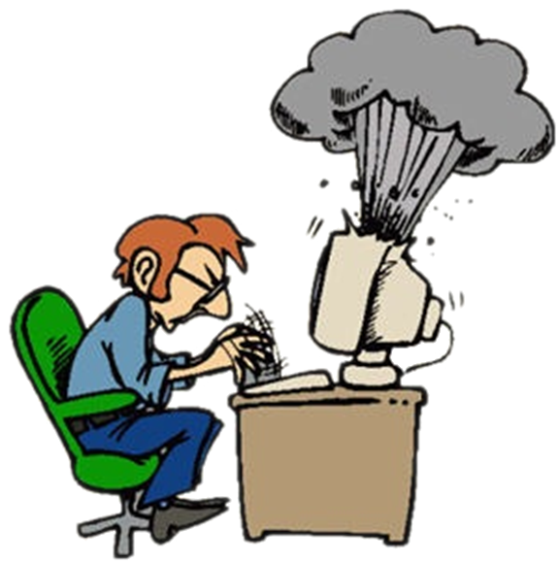

Computer Systems
Hardware related questions

Slide 3
Question 01
What does the Motherboard’s Southbridge do ?
Serves as the primary motherboard-level interconnect, connecting the host system-processor with both integrated-peripherals.
Supports the functions found on a processor, but in a standardized format.
Handles all of a computer's I/O functions, the interrupt controller and the IDE channels.
Handles communications among the CPU, in some cases RAM, and PCI Express (or AGP) video cards.

Slide 4
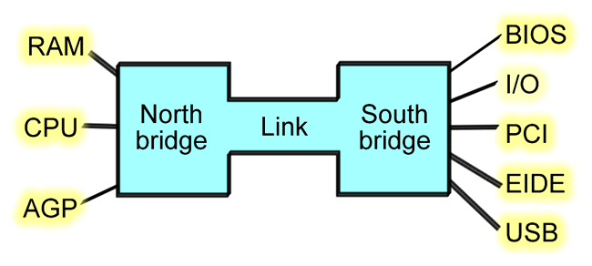
Answer 01
The Southbridge is one of the two chips in the core logic chipset on a personal computer (PC) motherboard, the other being the northbridge. The southbridge typically implements the slower capabilities of the motherboard in a northbridge / southbridge chipset computer architecture.
Sources: http://en.wikipedia.org/wiki/Southbridge_%28computing%29

Slide 5


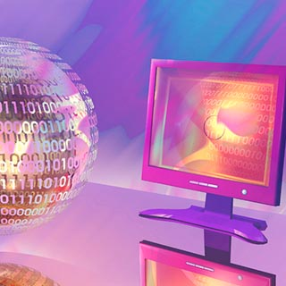
Software Systems
Computer Software

Slide 6
Question 02
What is ASP.NET ?
A server-side Web application framework designed for Web development to produce dynamic Web pages
A dynamic, reflective, object-oriented, general-purpose programming language
A server-side scripting language designed for web development but also used as a general-purpose programming language
A prototype-based scripting language with dynamic typing and has first-class functions

Slide 7

Answer 02
ASP.NET was developed by Microsoft to allow programmers to build dynamic websites, web applications and web services. It was first released in January 2002 with version 1.0 of the .NET Framework , and is the successor to Microsoft's Active Server Pages (ASP) technology. ASP.NET is built on the Common Language Runtime (CLR), allowing programmers to write ASP.NET code using any supported .NET language.
Sources: http://en.wikipedia.org/wiki/ASP.NET

Slide 8
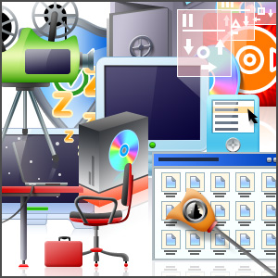

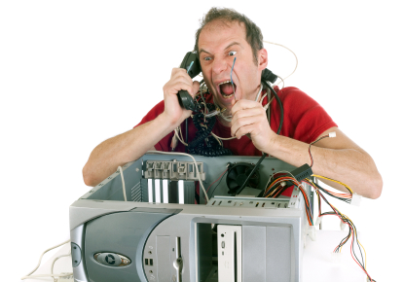
Working with Computer Systems and Programs
Installation, usage, support, …

Slide 9
Question 03
What is disk defragmentation?
The process of consolidating fragmented files on computer's hard disk
The process of cleaning up the cash memory and deleting the cookies
Part of the disk formatting process
Conversion from one file system into another
None of the above

Slide 10
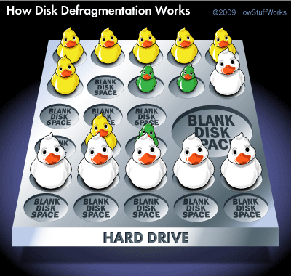
Answer 03
Fragmentation happens to a hard disk over time as you save, change, or delete files. The changes that you save to a file are often stored at a location on the hard disk that's different from the original file. Additional changes are saved to even more locations. Over time, both the file and the hard disk itself become fragmented, and your computer slows down as it has to look in many different places to open a file.
Sources :
http://goo.gl/Sh4BLY

Slide 11

Data Transfer and Numeral Systems
Data Transmission Channels, Measurement Units, Numeral Systems

Slide 12
Question 04
Serial communication is … ?
a communication system that transfers data between processor and memory in the computer
the process of sending data as a whole, on a link with several parallel channels
a method of communication to exchange data using radio waves
the process of sending data one bit at a time, sequentially

Slide 13
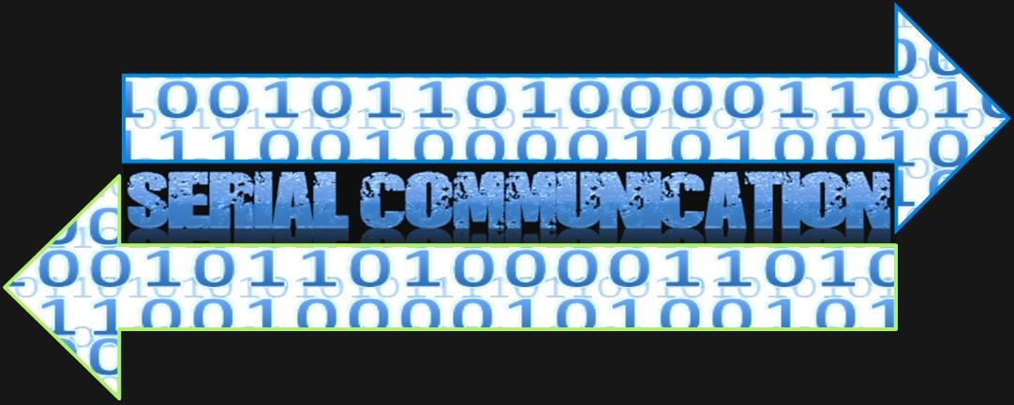
Answer 04
Serial communication is used for all long-haul communication and most computer networks, where the cost of cable and synchronization difficulties make parallel communication impractical.
Sources: http://en.wikipedia.org/wiki/Serial_communication

Slide 14





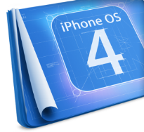








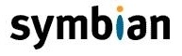
Operating Systems
Architectures, Processes, Users, User Interfaces, File Systems

Slide 15
Question 05
What is a journaling file system? A file system that:
has built-in support for report creation and review.
is used by journalists.
has built-in support for software versioning and revision control systems.
keeps track of the changes that will be made in a journal.
all of the above
none of the above

Slide 16

Answer 05
A journaling file system is a file system that keeps track of the changes that will be made in a journal (usually a circular log in a dedicated area of the file system) before committing them to the main file system. In the event of a system crash or power failure, such file systems are quicker to bring back online and less likely to become corrupted.
Sources:
http://en.wikipedia.org/wiki/Journaling_file_system

Slide 17
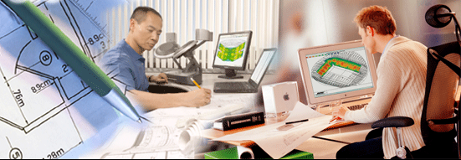
Software Engineering
Analysis, Specifications, Planning, Prototyping, Implementing, Testing, Support, …

Slide 18
Question 06
Which of the following is NOT a name of a Software Development Methodology ?
Dual Vee Model
Agile
Spiral
XP
Frosting
Scrum

Slide 19
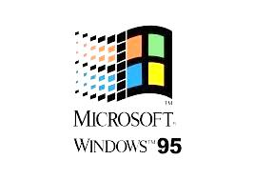
Answer 06
Frosting is the codename of Windows 95, given by Microsoft.
http://en.wikipedia.org/wiki/List_of_Microsoft_codenames
Dual Vee Model – goo.gl/RnQheP
XP – goo.gl/f9tgGx
Spiral – goo.gl/DYrdph
Agile – goo.gl/n4LHhg
Scrum – goo.gl/2SdV0l

Slide 20



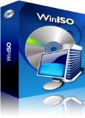
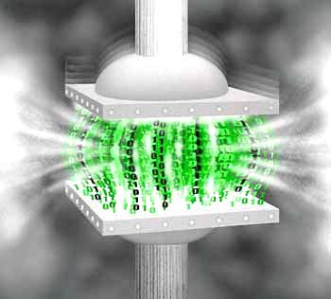




Data Compression
Compression Algorithms, Archiving Software

Slide 21
Question 07
On which line all of the mentioned formats and algorithms result in lossless compression?
TIFF, Lempel-Ziv-Welch, DEFLATE
bzip2, MP3, Huffmann Coding
Lempel-Ziv-Welch, Shannon-Fano Coding, JPEG
DjVu, Burrows-Wheeler Transform, Shannon-Fano Coding
а) and c)
on none of the above lines

Slide 22
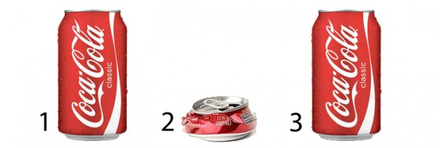
Answer 07
TIFF (Tagged Image File Format) is a file format for storing raster images.
Lempel-Zif-Welch is a universal lossless data compression algorithm. It is the algorithm of the widely used Unix file compression utility compress, and is used in the GIF image format.
DEFLATE is a data compression algorithm that uses a combination of the LZ77 algorithm and Huffman coding.
Sources:
http://goo.gl/Wb8nyR
http://goo.gl/40wFM5

Slide 23



Text Processing
Working with text processing software, file formats, encoding, text, tables, figures, …

Slide 24
Question 08
What is the purpose of the ASCII Control Characters?
а) to hold characters of non-Latin alphabets
b) to define the text processing
c) to determine the color, font and the size of the symbols
d) to ensure the usage of proper spelling and grammar
e) none of the above

Slide 25
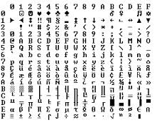
Answer 08
ASCII defines codes of 33 undepictable control characters (used mainly to determine the text processing). During the period of their introduction the printing devices were the most common tool for producing a text output. Therefore ASCII also contains control codes, specifying the way in which characters should be printed.
Sources:
http://en.wikipedia.org/wiki/ASCII

Slide 26
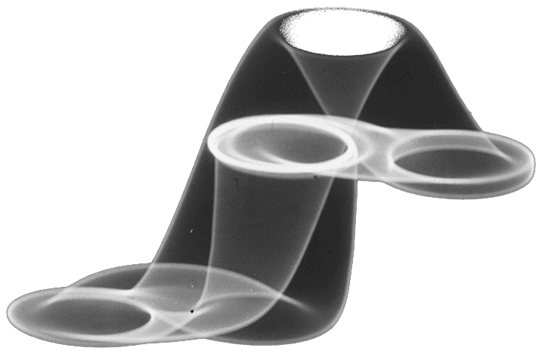



Computer Graphics
Raster and vector graphics, image file formats, image editors, color range

Slide 27
Question 09
Which of the following is NOT true about raster graphics?
It is a dot matrix data structure representing a generally rectangular grid of pixels
Produces images of high quality even after a significant scale up.
BMP, JPEG and TIFF are raster image formats
Each pixel can contain only one color
It is used for managing photographs and photo-realistic images

Slide 28
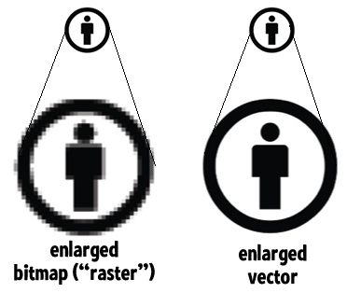
Answer 09
In Computer Graphics, raster graphics or bitmap image is a dot matrix data structure representing a generally rectangular grid of pixels, or points of color, i.e. each pixel in the image has a numeric value which stands for its color.
Sources: http://en.wikipedia.org/wiki/Raster_graphics
Vector Graphics - http://en.wikipedia.org/wiki/Vector_graphics

Slide 29

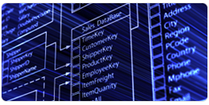


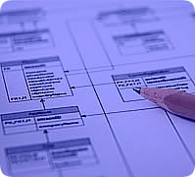

Databases
Database models, tables, relations, SQL

Slide 30
Question 10
Which of the following is NOT a database management system(DBMS)?
Oracle
MySQL
dBASE
FoxPro
FileMaker Pro
All of the above are DBMS

Slide 31
Answer 10
Oracle – is an object-relational DBMS produced and marketed by Oracle Corporation.
MySQL – one of the most popular open-source relational DBMS, widely used in web application development
dBASE – one of the first, widely used DBMS. Appeared in 1979.
FoxPro – procedurally oriented programming language and DBMS, originally published by Fox Software and later by Microsoft
FileMaker Pro - cross-platform relational DBMS, combined with GUI.
Sources: http://en.wikipedia.org/wiki/Database

Slide 32

Information Systems
ERP, CRM, BI, BPM, FMIS, CAD/CAM, CMS, software architectures

Slide 33
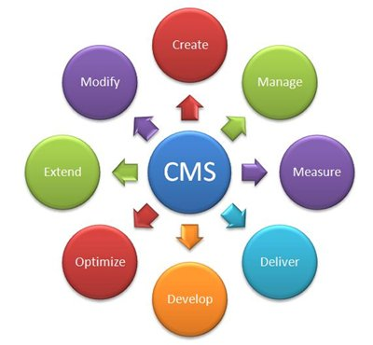
Question 11
Which of the following systems is a Content Management system (CMS) ?
Telerik Sitefinity
WordPress
Joomla
All of the above are CMS
None of the above is CMS

Slide 34


Answer 11
A content management system (CMS) is a computer program that allows publishing, editing and modifying content as well as maintenance from a central interface. Such systems of content management provide procedures to manage workflow in a collaborative environment. These procedures can be manual steps or an automated cascade. CMSs have been available since the late 1990s.
Sources: http://en.wikipedia.org/wiki/Content_management_system

Slide 35


Data Protection and Security
Symmetric and asymmetric encryption algorithms, cryptographic hashing, digital signature, public-key certificates

Slide 36
Question 12
What is NOT true about hardware-based security solutions ?
They can prevent read and write access to data.
Access is enabled only when the token is connected and correct PIN is entered.
The devices use biometric technology.
The current state of a user of the device is read by controllers in peripheral devices.
The hardware protects the operating system image and file system privileges from being tampered.
Hardware based access control is more secure than protection provided by the operating systems
All of the above are true.

Slide 37
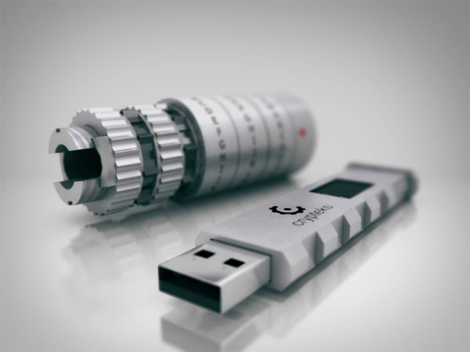
Answer 12
Hardware based or assisted computer security offers an alternative to software-only computer security. Security tokens such as those using PKCS#11 may be more secure due to the physical access required in order to be compromised. Access is enabled only when the token is connected and correct PIN is entered.
Sources:
http://goo.gl/HsvzgS

Slide 38




Presentation Systems
Presentation software, preparing presentations, slides, effects, notes, colors, images, audio, video

Slide 39
Question 13
Which of the following is considered a good practice for delivering presentations?
Making eye contact with the audience
Using slides containing only titles, keywords and images
Repeating aloud questions from the audience
Using non-verbal language
Political correctness
All of the above

Slide 40

Answer 13
Sources:
“How to give a killer presentation”
Harvard Business Review
http://hbr.org/2013/06/how-to-give-a-killer-presentation/
Tips on making presentations http://www.kent.ac.uk/careers/presentationskills.htm

Slide 41
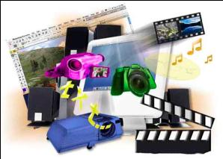

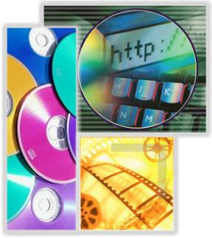

Multimedia
Multimedia processing software: audio, video file formats

Slide 42
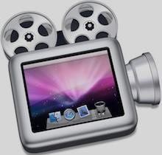
Question 14
Which program could be used to record your desktop actions ?
Skype
3D Studio Max
AutoCAD
Camtasia Studio
Visual Studio 2013

Slide 43
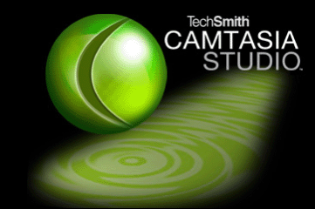
Answer 14
Use Camtasia's screen recorder to capture PowerPoint slides, software demos, webpages, and more. You can also import camera video, music, photos, and more to truly customize your screen recordings.
Sources: http://www.techsmith.com/camtasia.html

Slide 44

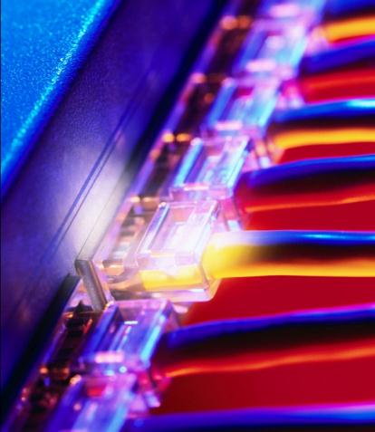
Computer Networks
OSI model, network models, protocols, standards, hardware devices

Slide 45

Question 15
Which of the following protocols is a part of the Application Layer of the TCP/IP model?
Telnet
TCP
IPv4
IPv6
All of the above

Slide 46
Answer 15
Telnet is a network protocol used on the Internet or local area networks to provide a bidirectional interactive text-oriented communication facility using a virtual terminal connection. User data is interspersed in-band with Telnet control information in an 8-bit byte oriented data connection over the Transmission Control Protocol (TCP).
Sources:
http://en.wikipedia.org/wiki/Internet_protocol_suite

Slide 47
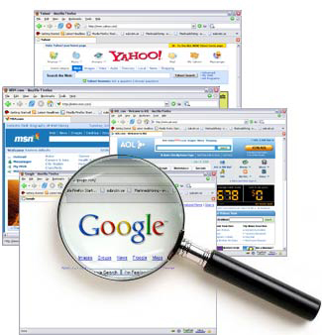


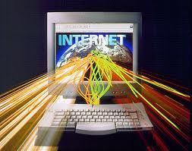
Structure of Internet
Internet, protocols, services, WWW, HTTP, FTP, SMTP, POP3, IMAP, WebDAV, IP, DNS, …

Slide 48

Question 16
Which of the following is a Wi-Fi encryption standard?
WED
WEB
WEP
WEL
None of the above

Slide 49
Answer 16
Wired Equivalent Privacy (WEP) is a security algorithm for IEEE 802.11 wireless networks. Introduced as part of the original 802.11 standard ratified in September 1999, its intention was to provide data confidentiality comparable to that of a traditional wired network.
Sources: http://en.wikipedia.org/wiki/Wired_Equivalent_Privacy
http://en.wikipedia.org/wiki/Wireless_security

Slide 50


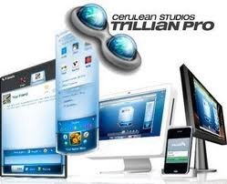

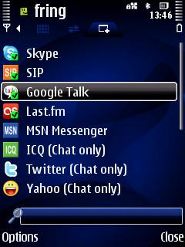
Digital Communication
E-mail, Skype, ICQ, IRC, MSN Messenger, Yahoo Messenger, social networks, forums, …

Slide 51
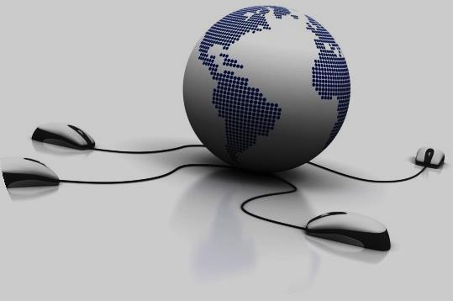
Question 17
Which of the following is NOT considered to be among the disadvantages of VoIP (Voice over Internet Protocol) technology?
Regular package loss
Slow package delivery
Echo
Signal interference
Network clogging
More expensive than a regular phone call

Slide 52

Answer 17
Voice over Internet Protocol (VoIP) is a methodology and group of technologies for the delivery of voice communications and multimedia sessions over Internet Protocol (IP) networks, such as the Internet. Other terms commonly associated with VoIP are IP telephony, Internet telephony, voice over broadband (VoBB), broadband telephony, IP communications, and broadband phone service.
Sources:
http://en.wikipedia.org/wiki/Voice_over_IP

Slide 53



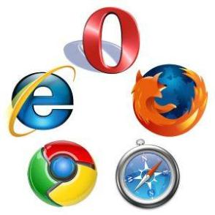
World Wide Web (WWW)
How does it work? HTTP, GET, POST, URL, web browser, web page, web site, …

Slide 54
Question 18
A website is :
a web document that is suitable for the World Wide Web and the web browser.
a set of related web pages served from a single web domain.
an application that uses a web browser as a client.
a software application for retrieving, presenting and traversing information resources on the World Wide Web.

Slide 55

Answer 18
A website, also written as Web site, web site, or simply site, is a set of related web pages served from a single web domain. A website is hosted on at least one web server, accessible via a network such as the Internet or a private local area network through an Internet address known as a Uniform resource locator. All publicly accessible websites collectively constitute the World Wide Web.
Sources:
http://en.wikipedia.org/wiki/Website

Slide 56


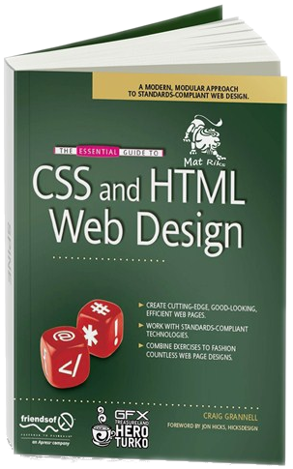

Web Design, HTML, CSS
Web design, HTML, CSS, text, graphics, links, tables, forms, …

Slide 57
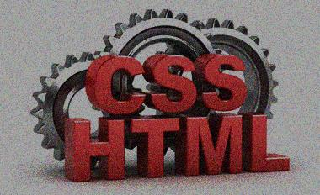
Question 19
Where in an HTML document is the correct place to refer to an external style sheet?
At the top of the document
At the end of the document
In the <body> section
In the <head> section
None of the above

Slide 58
Answer 19
An external style sheet is ideal when the style is applied to many pages. With an external style sheet, you can change the look of an entire Web site by changing one file. Each page must link to the style sheet using the <link> tag. The <link> tag goes inside the head section.
Sources:
http://www.w3schools.com/css/css_howto.asp

Slide 59





Scripting Languages and JavaScript
Developing scripts with JavaScript, main JavaScript libraries, operators, objects, DOM tree manipulation

Slide 60
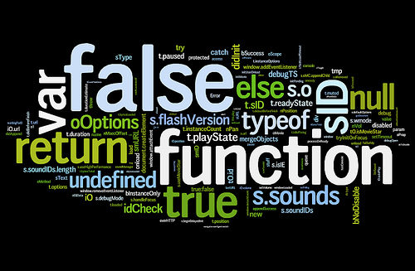
Question 20
Inside which HTML element do we put the JavaScript code?
<javascript>
<js>
<script>
<scripting>
None of the above

Slide 61
Answer 20
JavaScript code modules are a concept introduced in Gecko 1.9 and can be used for sharing code between different privileged scopes. Modules can also be used to create global JavaScript singletons that previously required using JavaScript XPCOM objects. A JavaScript code module is simply some JavaScript code located in a registered location. The module is loaded into a specific JavaScript scope, such as XUL script or JavaScript XPCOM script, using Components.utils.import() or Components.utils["import"]().
Sources:
http://goo.gl/ya1eEP

Slide 62
IT Practice Test
?
?
?
?
?
?
?
?
?
Questions?
?
?
?
?
?
?
?
?
?
?
Prepared By: Team Kurt Vonnegut

